Slide 1
EET 3404: Digital Circuit Design. Parity generator and checker.
GROUP 10 PRESENTATION.
GitHub repository:
https://github.com/joshuawambua/parity.git

Slide 2
Group Members
Joshua Wambua EG209/109705/22
Nason Alfred EG209/111030/22
Abuto Tonny Hillary -EG209/106792/21.
Collins Kimanthi --EG209/109696/22.
Wilkister Kwamboka -EG209/109739/22

Slide 3
INTRODUCTION
In digital systems, parity is a method used to ensure that data remains accurate when it is transmitted or stored. It works by adding a special bit, called a parity bit, to a set of data bits. This bit indicates whether the total number of 1s in the data is even or odd. For example, in even parity, the parity bit is chosen so that the total number of 1s (including the parity bit) becomes even. In odd parity, it is chosen so that the total number of 1s becomes odd.

Slide 4
Cont `
Parity checking helps detect errors that might occur when data is sent through communication channels or stored in digital memory. If a bit changes due to noise or interference, the receiver can quickly notice it by checking the parity. Although this method cannot correct the error, it provides a simple and effective way to identify when data has been altered, ensuring basic reliability in digital communication and storage systems.

Slide 5
TYPES OF PARITY: 1. Even parity.
In even parity, the parity bit is chosen so that the total number of 1s in the entire data set (including the parity bit) is an even number. For instance, if a data word contains three 1s, the parity bit is set to 1 to make the total number of 1s equal to four, which is even. Even parity is one of the most common error detection methods used in communication systems and memory storage because it offers a straightforward way to check data integrity. When the receiver counts an odd number of 1s instead of even, it knows that an error has occurred during transmission.

Slide 6
2. Odd parity
In odd parity, the parity bit is chosen so that the total number of 1s (including the parity bit) becomes an odd number. For example, if the data word already contains two 1s, the parity bit is set to 1 to make the total number of 1s three — an odd count. Odd parity works the same way as even parity but follows the opposite rule. It is used in systems or communication standards that require an odd count of 1s for consistency. Like even parity, it can detect single-bit errors efficiently, ensuring the accuracy of transmitted or stored data.

Slide 7
differences
Even Parity | Odd Parity
Total number of 1’s is even | Total number of 1’s is odd
Parity bit = 1 if data has odd 1’s | Parity bit = 1 if data has even 1’s
Example (1011 → parity = 1) | Example (1011 → parity = 0)
Common in memory systems | Used in some serial communications

Slide 8
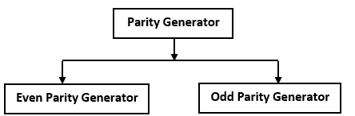

Slide 9
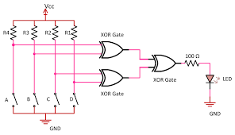
Circuit diagram – Even parity generator.

Slide 10
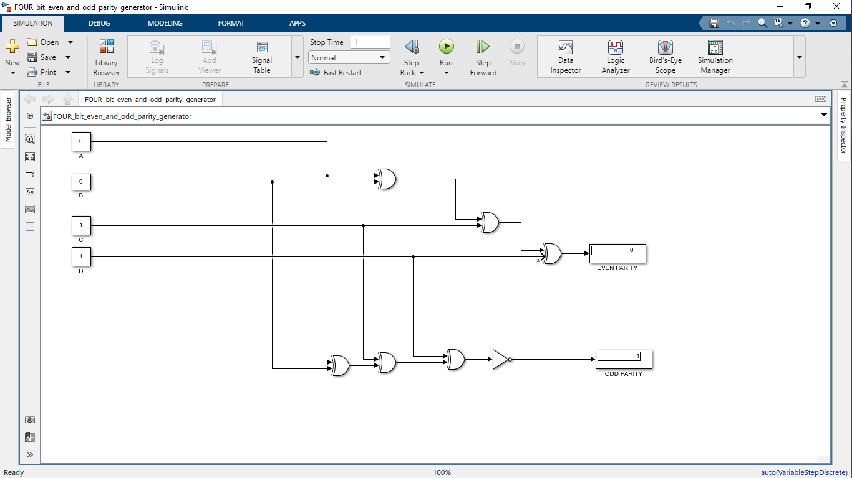
simulink circuit parity generator.

Slide 11
Truth tables 4 bit parity generator.
4-bit 3-bit

Slide 12
5-BIT

Slide 13
Parity checker
A parity checker is a digital circuit used to verify whether the received data has maintained the correct parity—either even or odd—after transmission or storage. It operates using XOR logic to compare all the data bits, including the parity bit. In the case of even parity, the total number of 1s in the data should be even; if the checker output is 0, it means the data is correct, while an output of 1 indicates an error. For odd parity, the total number of 1s should be odd; here, an output of 1 shows correct data, and an output of 0 signals an error. This method effectively detects single-bit errors and is widely used in digital communication systems, memory units, and microcontroller-based circuits to ensure data accuracy and reliability.

Slide 14
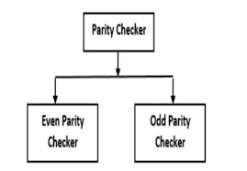

Slide 15
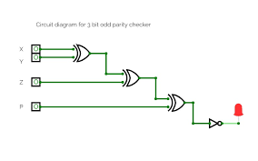
Circuit diagram – odd parity checker.

Slide 16
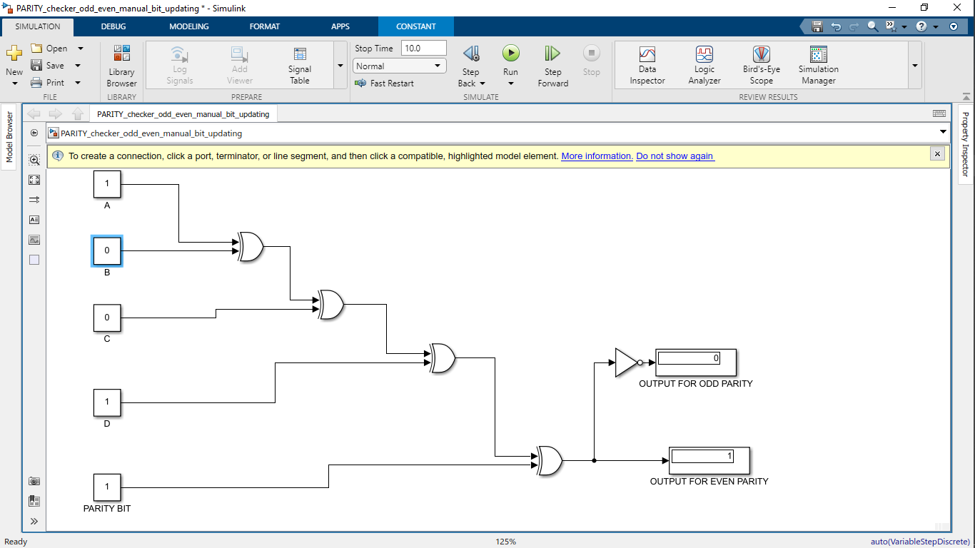
Simulink Parity checker.

Slide 17
Limitations of parity.
Parity checking can only detect single-bit errors.
It cannot detect errors that occur in two or more bits (even number of errors).
It cannot correct any detected error — it only signals that an error exists.
It requires an extra parity bit, increasing data size slightly.
It is not reliable for data transmitted over noisy channels.
It is inefficient for large data blocks, where better error detection methods are preferred.

Slide 18
Other error detection schemes.
Checksum method – Detects errors by adding all data bytes and comparing the sum at the receiver.
Cyclic Redundancy Check (CRC) –
Uses polynomial division to detect burst and multiple-bit errors.
3. Hamming code – Detects and corrects single-bit errors and detects double-bit errors.
4. Longitudinal Redundancy Check (LRC) –
Computes parity across data blocks (column-wise).
5. Vertical Redundancy Check (VRC) –
Adds a single parity bit to each data word.
6. Block Parity (Two-dimensional Parity) –
Combines row and column parity to detect and locate single-bit errors.

Slide 19
Error correction.(not possible with parity-you can’t correct using 1 bit.)
Redundant bits are added to the original data before transmission (not just one bit like parity).
These extra bits are placed in specific positions according to an error-correcting code (like Hamming code).
At the receiver end, the system checks all the parity (or check) bits again.
If an error occurs, the pattern of wrong parity bits indicates the exact position of the error.
The receiver flips that bit (0→1 or 1→0) to correct the data automatically.

Slide 20
APPLICATION OF PARITY
Used for error detection in digital communication systems.
Parity bits are widely used to detect single-bit errors during digital data transmission. When data is sent over a channel, noise or interference can flip a bit from 0 → 1
or vice versa. A parity checker compares the received parity bit with the recalculated one –
if they differ, an error is detected. This ensures reliable communication between devices.
.

Slide 21
Applications of parity.
2. Used in computer memory (RAM) to check for data corruption.
Some types of Random Access Memory (especially older systems and servers) include parity bits for every byte of data stored. When data is read back, the memory controller checks the parity — if the parity bit doesn’t match, an error is detected. While modern systems use ECC (Error Correction Code) memory, parity checking laid the foundation for such technologies.

Slide 22
Applications of parity.
3. Storage Media (Hard Drives, CDs, DVDs)
Data stored on physical media is vulnerable to scratches, dust, and magnetic decay. Parity bits (and parity-based schemes) are used to verify that data blocks are correctly written and retrieved. If mismatched parity is detected, the system knows that data corruption occurred and may attempt recovery or request retransmission.

Slide 23
Applications of parity.
4.Ensures data integrity during transmission and storage.
5. Applied in UART serial communication for detecting bit errors.
6. Implemented in network devices like modems and routers for error checking.
7. Forms the basis of advanced error detection codes such as Hamming Code.
8. Utilized in microcontrollers and embedded systems for reliable data exchange.
9. Applied in satellite and space communication to detect bit flips caused by noise or radiation.

Slide 24


